Slide 1
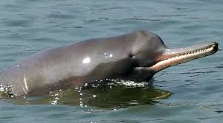
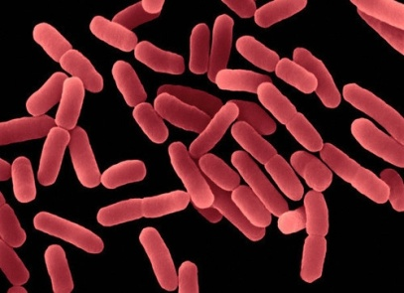
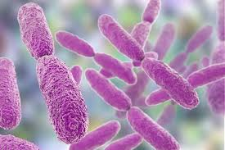
Changes in microbial communities in response to Covid-19 forced lockdown at dolphin spotting site (Garhmukteshwar) of the River Ganga
Diwakar Prakash¹, Raunak Dhanker² and Ram Kumar¹
¹Ecosystem Research Lab, Department of Environmental Science, School of Earth, Biological and Environmental Sciences, Central University of South Bihar, SH-7, Gaya-Panchanpur Rd. Gaya 824236, Bihar, India.
²School of Applied Life Science, GD Goenka University, Gurgaon

Slide 2
Introduction
The River Ganga is the habitat for a considerable number of endemic and endangered species, including the Gangetic River dolphin, Platanista gangetica gangetica (Roxburgh, 1801).
Discharging faecal wastes and urination in open spaces near Ganga shoreline makes the Ganga faecal contamination (Reasoner,1982).
22 Dolphin was recorded in 1993-95 approximately and 56 Dolphins were recorded in 2010 between Bijnor and Narora Barrages (approx. 166 km) (Behera 1995)
In river ecosystems, Dolphins are factors play the important role in aquatic ecology by shaping the composition of microbial community (Winter et al., 2007; Liu et al ., 2011)

Slide 3
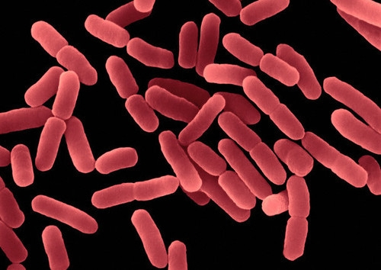
Objective
To study the changes in microbial communities in response to Covid-19 forced lockdown at dolphin spotting site (Garhmukteshwar) of the River Ganga

Slide 4
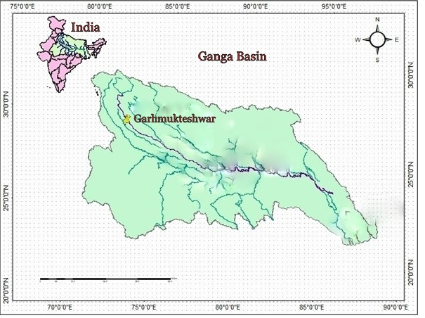
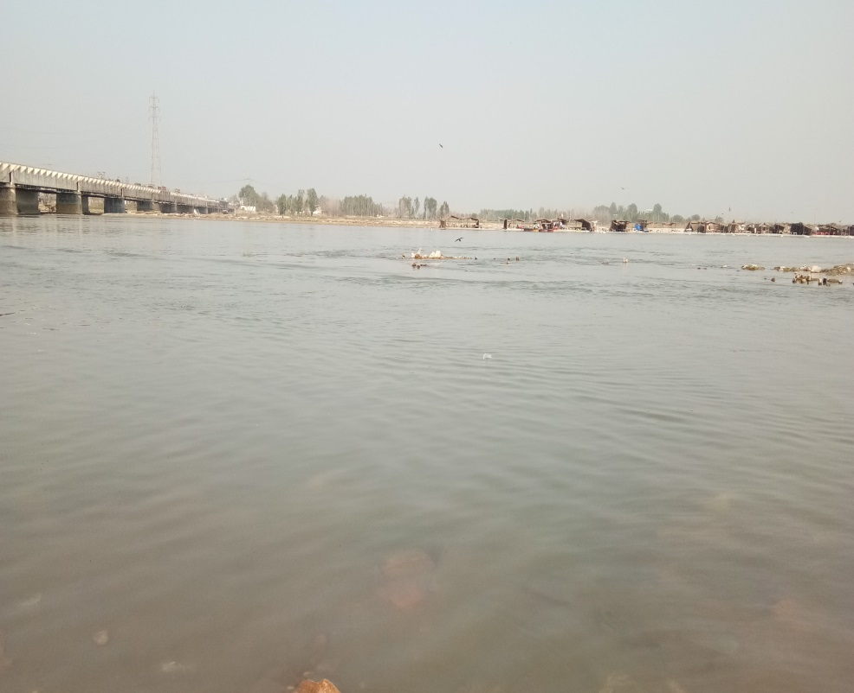
Materials and Methods
The water samples collected immediately after dolphin was spotted at the site Garhmukteshwar (28.7601°N, 78.1437°E) Uttar Pradesh, India.
Garhmukteshwar (28.7601°N, 78.1437°E)
Fig. Sampling site ( Garhmukteshwar) in River Ganga

Slide 5
Materials and Methods Cont.
The water samples for bacterial analyses were taken in five replicates at sampling site.
The bacterial samples were kept in the laboratory at -21⁰C
Total coliform was analysed in three steps: MacCkonky Broth,-Brilliant Green Bile Broth- Luria Bertani Agar and finally colony counting method was applied to estimate the density.
Bacterial identification from the samples collected, immediately after emergence of dolphin in February 2018 was done by genotyping using 16S rRNA

Slide 6
Results
During Covid-19 lockdown
Fig. Most probable Number of total coliform at Garhmukteshwar

Slide 7
Results

Slide 8
The total bacterial population was observed 26000 cfu/ml and it was 90% dominated by Bacillus subtilis in February 2018
CAGGACGAACGCTGGCGGCGTGCCTAATACATGCAAATCGAGCGGACAGATGGGAGCTTG
CTCCCTGATGTTAGCGGCGGACGGGTGAGTAACACGTGGGTAACCTGCCTGTAAGACTGG
GATAACTCCGGGAAACCGGGGGTAATACCGGATGGTTGTTTGAACCGCATGGTTCAAACA
TAAAAGGTGGCTTCTGCTATCACTTACAGATGGACCCGCGGCGCATTAGCTAGTTGGTGA
GGTGACGGCTCTCCAAGGCGACGATGCGTAGCCGACCTGAGAGGGTGATCGGCCACACTG
GGAGTGAGACACGGCCCAGACTCCTACGGGAGGCAGCAGTAGGGAATCTTCCGCAATGGA
CGAAAGTCTGACGGAGCAACGCCGCGTGAGTGATGAAGGTTTTCGGATCGTAAAGCTCTG
TTGTTAGGGAAGAACAAGTACCGTTCGAATAGGGCGGTACCTTGACGGTGCCTAACCAGA
AAACCCCGGCTAACTACGTGCCAGCAGCCGCGGTAATACGTAGGTGGCAAGCGTTGTCCG
GAATTATTGGGCGTAAAGGGGTCGCAGGCGGTTTTTTAAGTCTGATGTGAAAACCCCCGG
CTCAACCGGGGAGGGTCATTGGAAACTGGGGAACTTGAGTGCAGAAGAGGAGAGTGGAAT
TCCCCGTGTAGCGGTGAAATGCGTAGAGATGTGGAGGAACACCAGTGGCGAAGGCGACTC
TCTGGTCTGTAACTGACGCTGAGGAGCGAAAGCGTGGGGAGCGAACAGGATTAGATACCC
TGGTAGTCCACGCCGTAAACGATGAGTGCTAAGTGTTAGGGGGTTTCCGCCCCTTAGTGC
TGCAGCTAACGCATTAAGCACTCCGCCTGGGGAGTACGGTCGCAAGACTGAAACTCAAAG
GAATTGACGGGGGCCCGCACAAGCGGTGGAGCATGTGGTTTAATTCGAAGCAACGCGAAG
AACCTTACCAGGTCTTGACATCCTCTGACAATCCTAGAGATAGGACGTCCCCTTCGGGGG
CAGAGTGACAGGTGGTGCATGGTTGTCGTCAGCTCGTGTCGTGAGATGTTGGGTTAAGTC
CCGCAACGAGCGCAACCCTTGATCTTAGTTGCCAGCATTCAGTTGGGCACTCTAAGGTGA
CTGCCGGTGACAAACCGGAGGAAGGTGGGGATGACGTCAAATCATCATGCCCCTTATGAC
CTGGGCTACACACGTGCTACAATGGACAGAACAAAGGGCAGCGAAACCGCGAGGTTAAGC
CAATCCCACAAATCTGTTCTCAGTTCGGATCGCAGTCTGCAACTCGACTGCGTGAAGCTG
GAATCGCTAGTAATCGCGGATCAGCATGCCGCGGTGAATACGTTCCCGGGCCTTGTACAC
ACCGCCCGTCACACCACGAGAGTTTGTAACACCCGAAGTCGGTGAGGTAACCTTTTAGGA
GCCAGCCGCCGAAGGTGGGACAGATGATTGGGGTG
Consensus Sequence of Bacillus subtilis

Slide 10
Conclusions
Bacterial community were assessed by collecting sample from the exact site where dolphins were spotted
The observed data clearly indicates that bacterial load has reduced due to Covid-19 lockdown in river Ganga at Garhmukteshwar.
Study revealed the differences of microbiota before and during the lockdown
The present results will form the baseline information for planning the dolphin conservation and restoration of the river Ganga.
The bacterial communities identified in this study might be informative for future health monitoring of Gangetic dolphins.
However, only the data of Feb 2018 were sequenced, a thorough sequencing may provide more constructive conclusion

